Slide 1
Exploring Biodiversity & Conservation in National Parks
27/05/2025
Data-Driven Insights for Conservation Strategies.
Gabriel Arcangel Bol

Slide 2
Species Data Overview
This dataset provides a comprehensive view of species in national parks, categorized by conservation status.
📌 Dataset: species_info.csv 🔍 Key Insights from Analysis:
Total species analyzed: 5,824
Divided into 7 categories
Most frequent species group: Vascular Plants
Species of Concern is the most common conservation status
Missing values: 5,633 entries in conservation_status
💡 Explanation of dataset purpose and relevance in biodiversity research.

Slide 3

Significance Testing - Endangered Status Analysis
📌 Chi-Square Test for Conservation Status
📊 Statistical test applied:
🔬 Results:
✅ Chi-Square Statistic: 53.916
✅ P-value: 1.89e-05
💡 Interpretation: Since the p-value is very small, we conclude that species categories significantly influence conservation status—some groups are more vulnerable than others. We tested whether species category significantly impacts conservation status.

Slide 4
Conservation Recommendations
📌 Actionable Conservation Measures 🔍 Based on findings, we recommend:
Prioritizing birds and vascular plants as they are at higher risk.
Monitoring "Species of Concern" to prevent them from becoming endangered.
Preserving ecosystems for mammals like Puma concolor and Procyon lotor, which show adaptability.
Implementing stronger biodiversity policies based on species observation trends.
💡 Science-based recommendations to enhance conservation programs.

Slide 5
Visual Representations
📌 Graphs & Key Observations:
Conservation status distribution
Endangered species trends by category
Most observed species per park
Top 5 most observed species per park
Sample size determination for foot and mouth disease

Slide 6
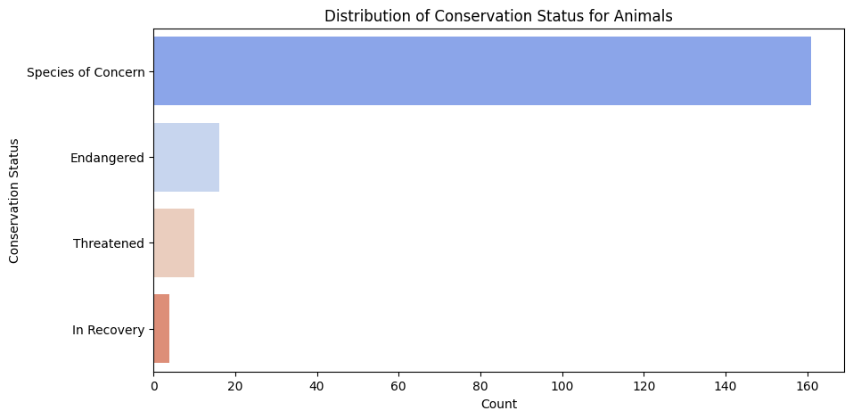
Conservation status distribution
📌 Introduction: This visualization highlights the distribution of species across different conservation status categories, helping identify priority areas for conservation efforts.
🖼 Graph & Caption: Figure: Conservation Status Distribution of Species
🔍 Key Insights:
Species of Concern is the most frequent conservation category.
Endangered species make up a smaller percentage but require critical attention.
Threatened and In Recovery species are even fewer, showing some ongoing conservation success.
Chi-square analysis confirms significant differences between species groups.
💡 Takeaway: Understanding conservation status trends helps guide policies focused on species at risk, ensuring proper interventions before they reach critical endangerment levels.

Slide 7
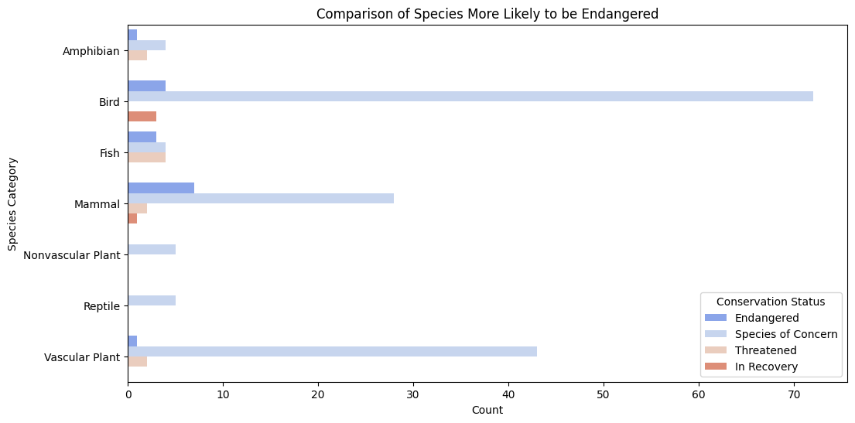
Endangered species trends by category
📌 Introduction: This visualization illustrates which species categories are more vulnerable to endangerment, supporting strategic conservation prioritization.
🖼 Graph & Caption: Figure: Endangered Species Count by Category
🔍 Key Insights:
Birds and vascular plants have the highest number of endangered species, indicating ecological pressures on these groups.
Mammals also show considerable presence in endangered classifications.
Reptiles, amphibians, and fish exhibit fewer endangered species, possibly due to differing habitat or population dynamics.
Chi-square analysis reinforces this vulnerability trend, confirming statistically significant differences.
💡 Takeaway: Targeted conservation efforts should focus on birds and vascular plants, as they face the highest risks from environmental threats.

Slide 8
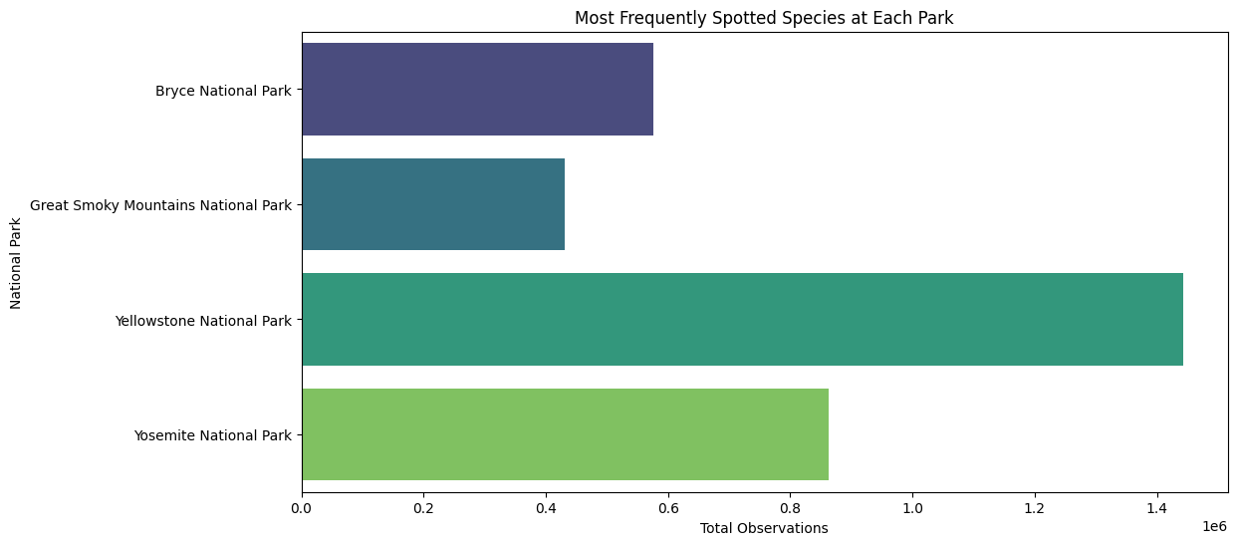
Most observed species per park
📌 Introduction: This visualization highlights the most frequently recorded species across major national parks, providing insights into species distribution and habitat adaptability.
🖼 Graph & Caption: Figure: Most Observed Species in Each National Park
🔍 Key Insights:
Yosemite National Park: Most observed species include Hypochaeris radicata, Castor canadensis, Holcus lanatus, Streptopelia decaocto, and Procyon lotor.
Yellowstone National Park: Species such as Hypochaeris radicata, Holcus lanatus, Streptopelia decaocto, Procyon lotor, and Puma concolor are frequently recorded.
Great Smoky Mountains National Park: Castor canadensis, Streptopelia decaocto, Procyon lotor, Puma concolor, and Fragaria virginiana are among the most observed.
Bryce National Park: Most common species include Streptopelia decaocto, Puma concolor, Columba livia, Avena sativa, and Myotis lucifugus.
💡 Takeaway: Species distribution across parks suggests that some species are widespread and adaptable, while others are more localized to specific environments. These findings support targeted conservation strategies to preserve habitats where biodiversity is most concentrated.

Slide 9
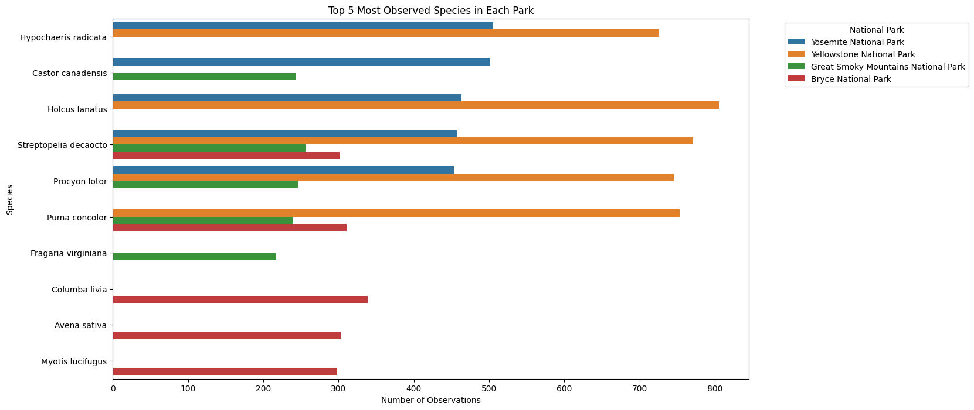
Top 5 - Most observed species per park
📌 Introduction: This visualization highlights the most frequently recorded species across major national parks, offering insights into species distribution and adaptability.
🖼 Graph & Caption: Figure: Observation Counts of Species Per Park
🔍 Key Insights:
Holcus lanatus had the highest recorded observations in Yellowstone National Park (805 sightings).
Streptopelia decaocto appears frequently across multiple parks, demonstrating adaptability.
Puma concolor and Procyon lotor exhibit habitat flexibility, appearing across diverse environments.
Castor canadensis and Hypochaeris radicata are widely distributed across parks, reinforcing species success in various habitats.
Some species are highly localized, while others thrive across multiple national parks.
💡 Takeaway: Understanding species distribution is crucial—widely spread species require habitat preservation, while localized species need targeted interventions.

Slide 10

Sample Size Determination - Foot and Mouth Disease Study
📌 Introduction: This visualization presents the statistical approach used to determine the required sample size for foot and mouth disease prevalence estimation.
🖼 Graph & Caption: Figure: Sample Size Calculation for Disease Monitoring
🔍 Key Insights:
Statistical formula applied:
Z-score used: 1.96 (for 95% confidence level).
Estimated disease prevalence: 5%.
Final sample size: 73 observations (adjusted).
Ensures epidemiological research validity, supporting effective disease monitoring.
💡 Takeaway: Accurate sample size determination is essential for epidemiological studies, ensuring valid disease prevalence estimates to guide public health interventions.

Slide 11
Key Findings & Takeaways
📌 Key Findings & Takeaways
✅ High-risk species require prioritized conservation efforts, particularly birds and vascular plants.
✅ Statistical analysis confirms significant differences in conservation status among species groups.
✅ Sample size calculation ensures accurate disease prevalence monitoring, supporting effective epidemiological research.
🎯 Future Research Directions
📊 Investigate environmental drivers affecting species survival and conservation outcomes. 🔍 Develop predictive models for biodiversity loss and species adaptation under climate change scenarios. 🛡 Enhance conservation policies using data-driven approaches, integrating ecological and epidemiological findings.
💡 Next Steps:
Apply findings to real-world conservation planning, informing targeted interventions.
Expand research to long-term monitoring strategies for endangered species.
Strengthen collaboration between wildlife conservationists, ecologists, and public health experts for integrated solutions.

